Slide 1
Scheduling Techniques for GPU Architectures with Processing-In-Memory Capabilities
Conference : PACT’2016
Author : Ashutosh Pattnaik,Xulong Tang,Adwait Jog,Onur Mutlu
Research unit : Pennsylvania State University,Carnegie Mellon University……

Slide 2
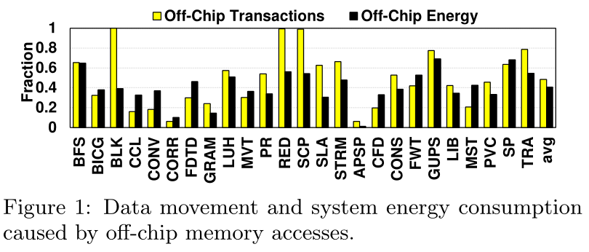
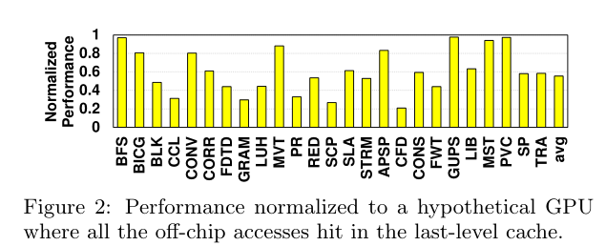
Research work—Background
PIM can greatly alleviate the performance and energy penalties of data transfers from/to main memory.
GPU architectures and applications, where main memory bandwidth is a critical bottleneck, can benefit from the use of PIM.

Slide 3
Research work—Background
PIM can greatly alleviate the performance and energy penalties of data transfers from/to main memory.
GPU architectures and applications, where main memory bandwidth is a critical bottleneck, can benefit from the use of PIM.
序号 | 名称 | 算法名称
1 | BFS | 广度优先搜索算法
2 | BICG | 双共轭梯度法
3 | BLK | Black-Scholes偏微分方程数值求解
4 | CCL | 连通分量标记算法
5 | CONV | 卷积算法
6 | CORR | 相关系数函数求解算法
7 | FDTD | 时域有限差分法
8 | GRAM | 字符串模糊匹配算法
9 | LUH | 数字校验算法
10 | MVT | 矩阵向量乘积与转置算法
11 | PR | pagerank算法
12 | RED | 随机早期检测算法
13 | SCP | 联邦拜占庭算法
14 | SLA | 服务等级协议算法
15 | STRM
16 | APSP | 所有对最短路径算法
17 | CFD | 计算流体动力学
18 | CONS
19 | FWT | 快速沃尔什变换
20 | GUPS
21 | LIB | Libor市场模型的Monte Carlo控制变量加速方法
22 | MST | 最小生成树算法
23 | PVC
24 | SP | 压缩感知中一种非常重要的贪婪算法
25 | TRA

Slide 4
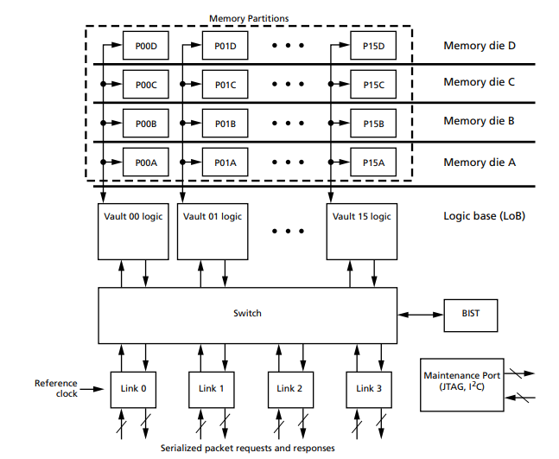
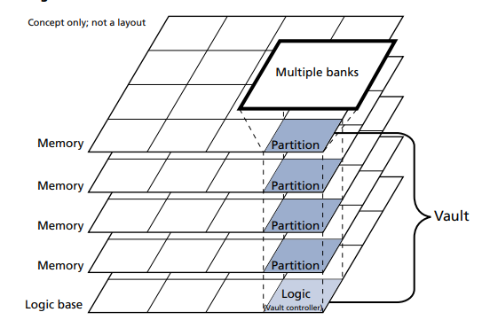
Research work—HMC
Power consumption & Price & JEDEC Standard.

Slide 5
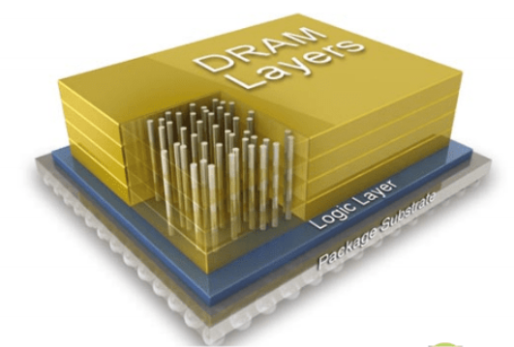
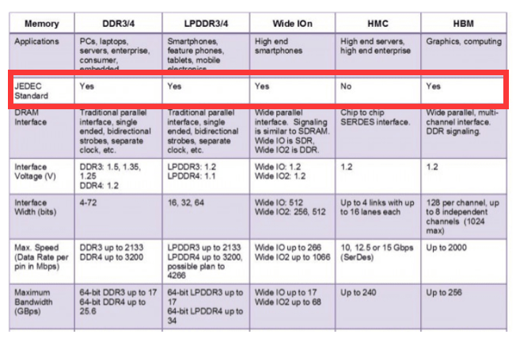

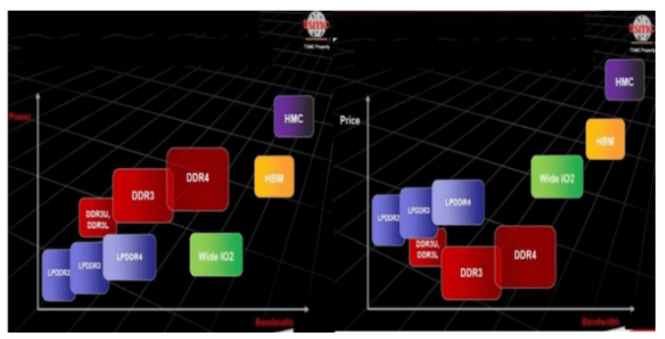
Research work—HBM vs HMC
Power consumption & Price & JEDEC Standard.
JEDEC-Joint Electron Device Engineering Council.

Slide 6
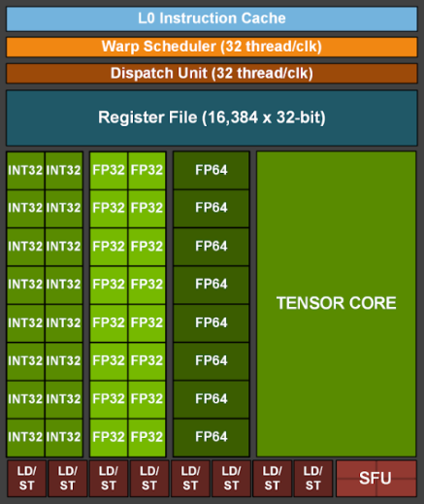
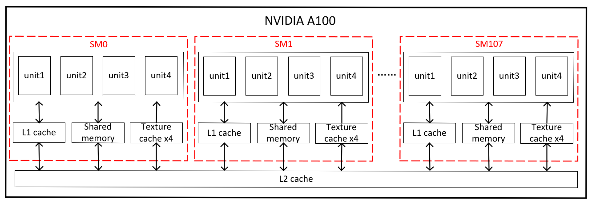
Research work—GPU
7 GPCs, 7 or 8 TPCs/GPC, 2 SMs/TPC, up to 16 SMs/GPC, 108 SMs.
64 FP32 CUDA Cores/SM, 6912 FP32 CUDA Cores per GPU.
4 third-generation Tensor Cores/SM, 432 third-generation Tensor Cores per GPU.
16K x 4byte register file per unit.

Slide 7
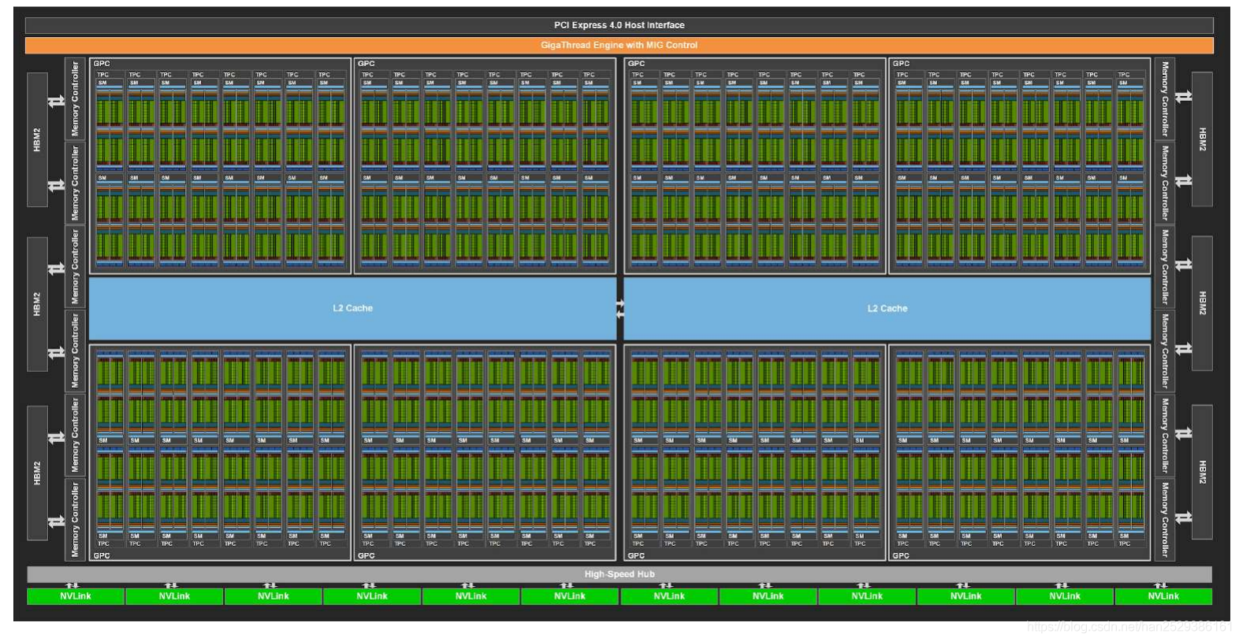
Research work—GPU

Slide 8
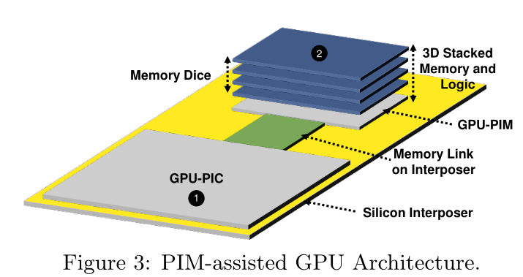
Research work—Problem & Motivation
GPU-PIC and GPU-PIM architectures are quite different in terms of their ability to cater to applications with varying computation and memory demands.
Offloading a compute-bound GPGPU application onto GPU-PIC.
Offloading a memory-bound GPGPU application onto GPU-PIM.

Slide 9
Research work—Solution
Proposing two new runtime techniques.
Kernel Offloading.
Concurrent Kernel Management.

Slide 10
Research work—Challenge
How to automatically identify the code segments to be offloaded to the GPU cores in memory?
What the granularity of the code segment that is offloaded to GPU-PIM should be?
How to determine which code segments benefit from being executed on GPU-PIM?
How to concurrently schedule multiple kernels on the main GPU and the cores in memory?
How to efficiently distribute work between the main GPU and the PIM engine to maximize system performance, while executing each code segment on its preferred cores as much as possible?

Slide 11
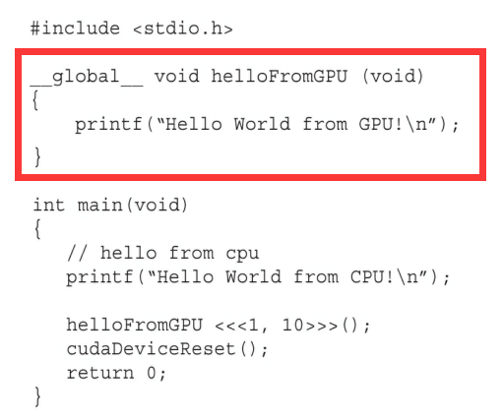
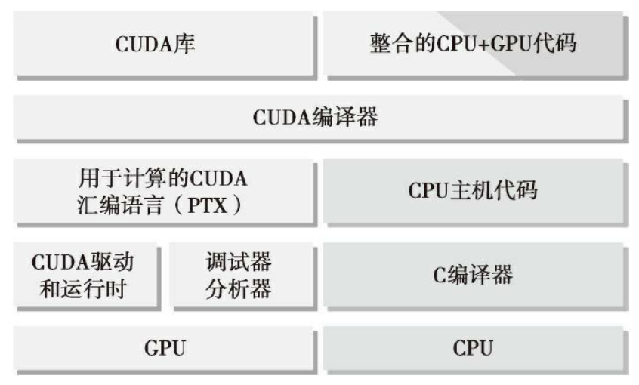
Research work—Technique
What the granularity of the code segment that is offloaded to GPU-PIM should be?
Kernel granularity.
CPU offloads computation to the GPU at the kernel granularity, maintaining the same granularity for PIM execution enables low-overhead computation offloading from the CPU to both GPU-PIC and GPU-PIM.
Kernels are defined by programmer.

Slide 12
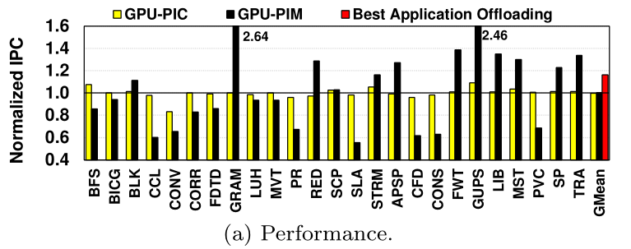
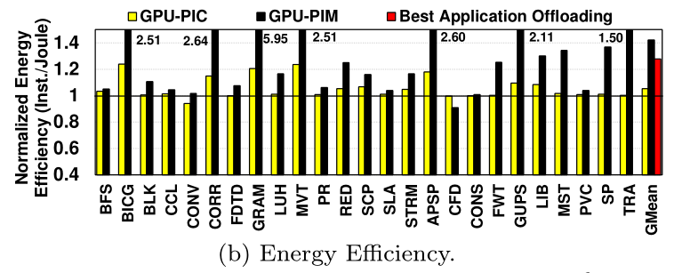
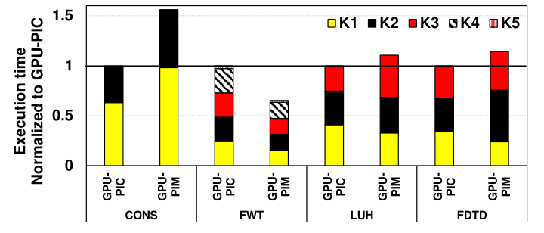
Research work—Technique
Kernel Offloading Mechanism.

Slide 13
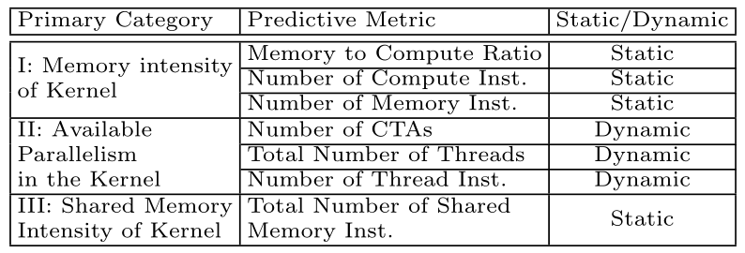
Research work—Technique
Kernel Offloading Mechanism.
An prediction model to enable a run time mechanism for kernel offloading.
Metrics-character the kernel affinity to GPU-PIC or GPU-PIM.
(1) Memory intensity.
a. Memory to Compute Ratio : memory-to-compute-ratio of the instruction mix executed by that particular kernel.
b. Number of Compute Inst.
c. Number of Memory Inst.
(2) Parallelism.
(3) Shared memory intensity.

Slide 14
Research work—Technique
Kernel Offloading Mechanism.
An prediction model to enable a run time mechanism for kernel offloading.
Metrics-character the kernel affinity to GPU-PIC or GPU-PIM.
(1) Memory intensity.
(2) Parallelism.
a. Number of CATs - the number of cooperative thread arrays (CTAs) (also called work groups or thread
blocks) as a measure of the parallelism in the kernel.
b. Total Number of Threads.
c. Number of Thread Inst.
(3) Shared memory intensity.
a. Total Number of Shared Memory Inst.

Slide 15
Research work—GPU
7 GPCs, 7 or 8 TPCs/GPC, 2 SMs/TPC, up to 16 SMs/GPC, 108 SMs.
64 FP32 CUDA Cores/SM, 6912 FP32 CUDA Cores per GPU.
4 third-generation Tensor Cores/SM, 432 third-generation Tensor Cores per GPU.
16K x 4byte register file per unit.

Slide 16
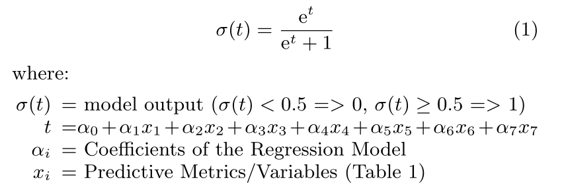
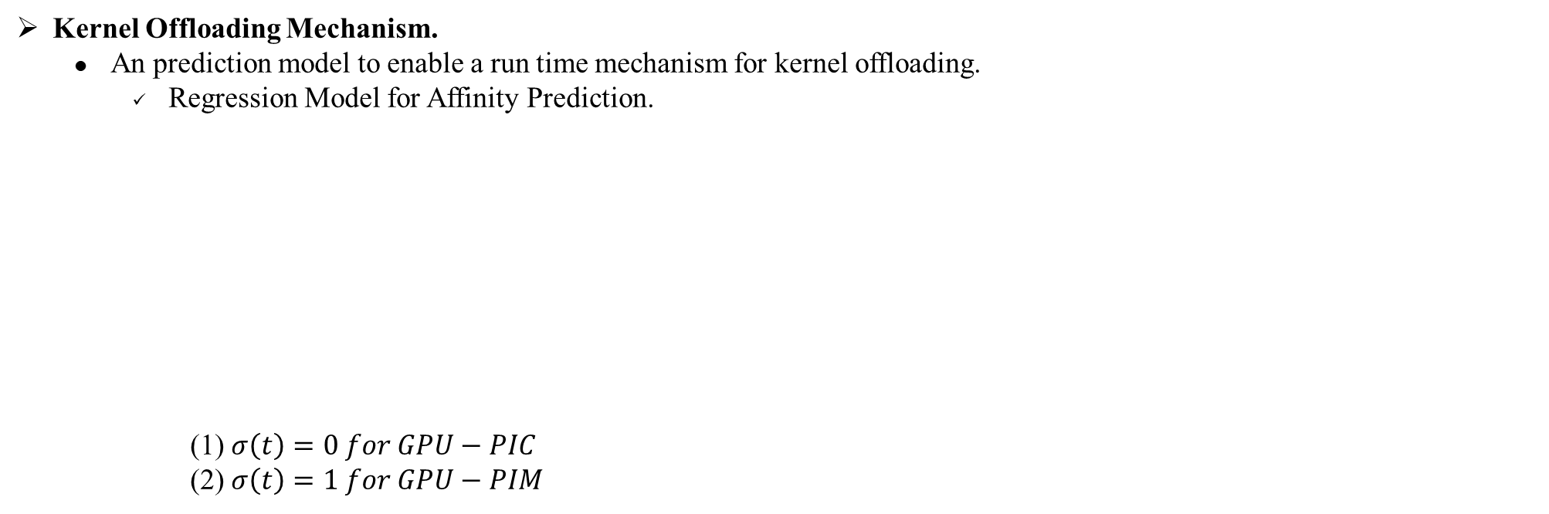
Research work—Technique
Kernel Offloading Mechanism.
An prediction model to enable a run time mechanism for kernel offloading.
Regression Model for Affinity Prediction.
(1) $σ\left(t\right)=0 for GPU−PIC$
(2)$σ\left(t\right)=1 for GPU−PIM$
Train set and test set.
(1) Randomly sample 60%(15) of the 25 GPGPU applications which consist 82 unique kernels as train set.
(2) Using 40%(10) of the 25 GPGPU applications which consist 42 unique kernels as test set.
Accuracy : 83%.
Factors affecting accuracy : Cache effects and branch divergence which have heavily runtime-dependence characters.

Slide 17
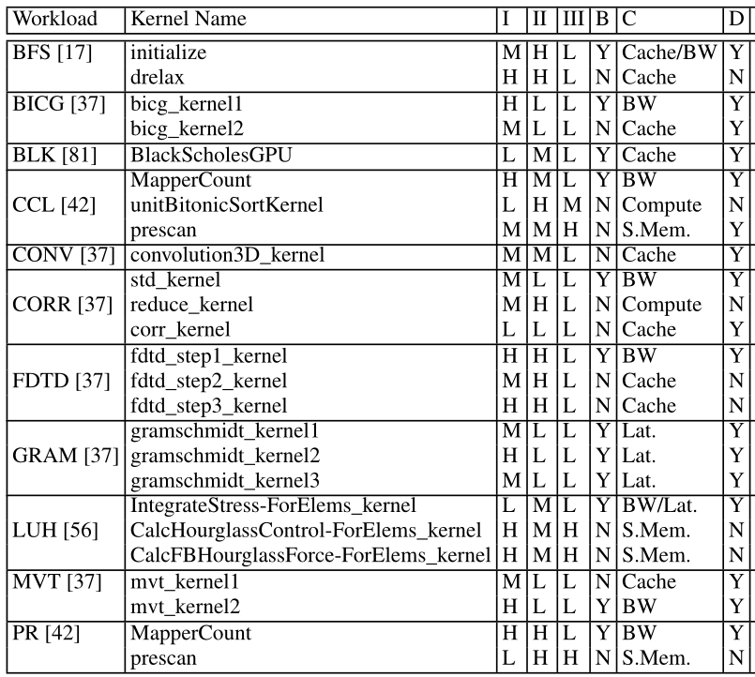
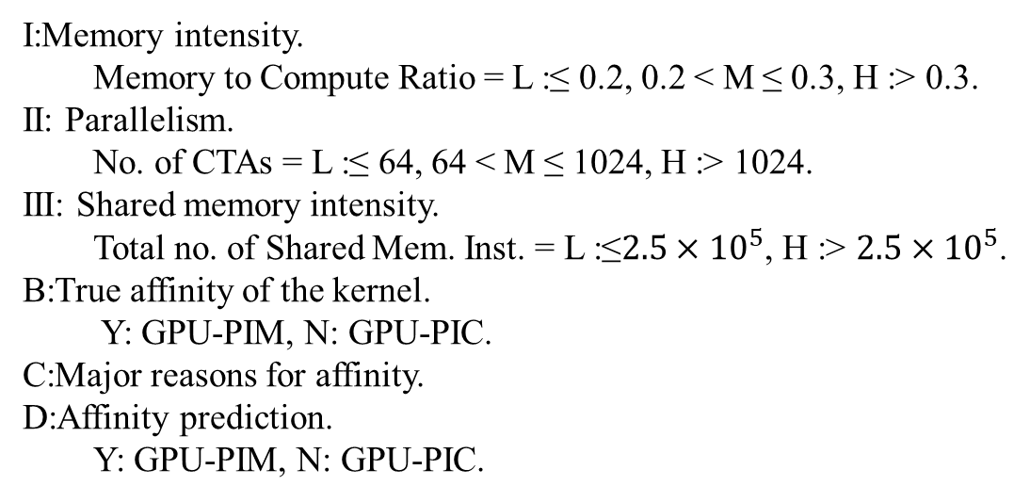
Research work—Technique
Kernel Offloading Mechanism.
An prediction model to enable a run time mechanism for kernel offloading.
Regression Model for Affinity Prediction.
I:Memory intensity.
Memory to Compute Ratio = L :≤ 0.2, 0.2 < M ≤ 0.3, H :> 0.3.
II: Parallelism.
No. of CTAs = L :≤ 64, 64 < M ≤ 1024, H :> 1024.
III: Shared memory intensity.
Total no. of Shared Mem. Inst. = L :≤$2.5×{10}^{5}$, H :> $2.5×{10}^{5}$.
B:True affinity of the kernel.
Y: GPU-PIM, N: GPU-PIC.
C:Major reasons for affinity.
D:Affinity prediction.
Y: GPU-PIM, N: GPU-PIC.

Slide 18
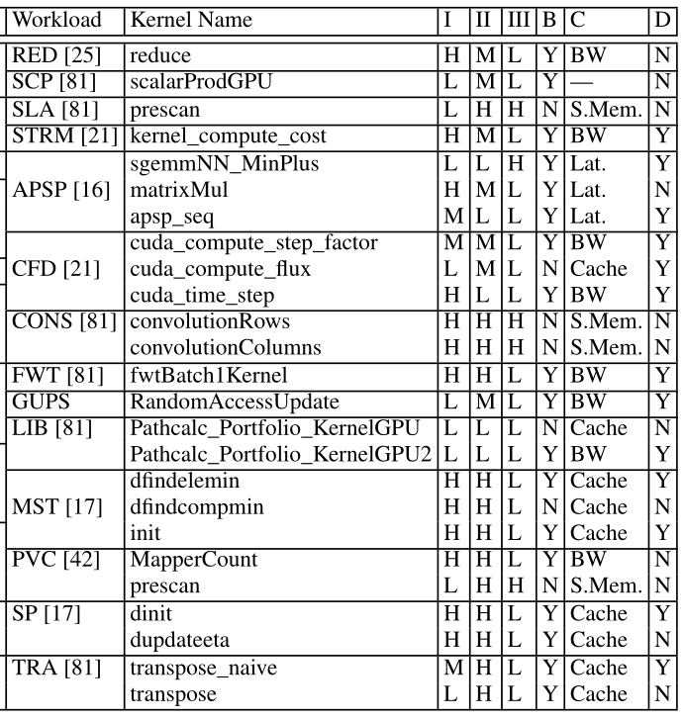
Research work—Technique
Kernel Offloading Mechanism
An prediction model to enable a run time mechanism for kernel offloading.
Regression Model for Affinity Prediction.
I:Memory intensity.
Memory to Compute Ratio = L :≤ 0.2, 0.2 < M ≤ 0.3, H :> 0.3.
II: Parallelism.
No. of CTAs = L :≤ 64, 64 < M ≤ 1024, H :> 1024.
III: Shared memory intensity.
Total no. of Shared Mem. Inst. = L :≤$2.5×{10}^{5}$, H :> $2.5×{10}^{5}$.
B:True affinity of the kernel.
Y: GPU-PIM, N: GPU-PIC.
C:Major reasons for affinity.
D:Affinity prediction.
Y: GPU-PIM, N: GPU-PIC.

Slide 19
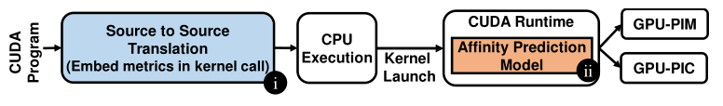
Research work—Technique
Kernel Offloading Mechanism.
An prediction model to enable a run time mechanism for kernel offloading.
Implementation.
Source to Source Translation : Computing the values of static metrics.
CUDA Runtime : Getting the dynamic metrics.

Slide 20
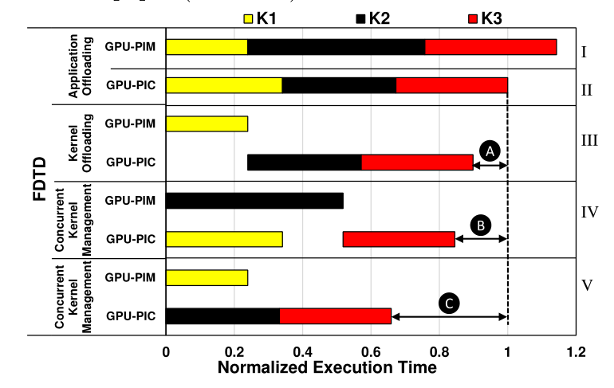
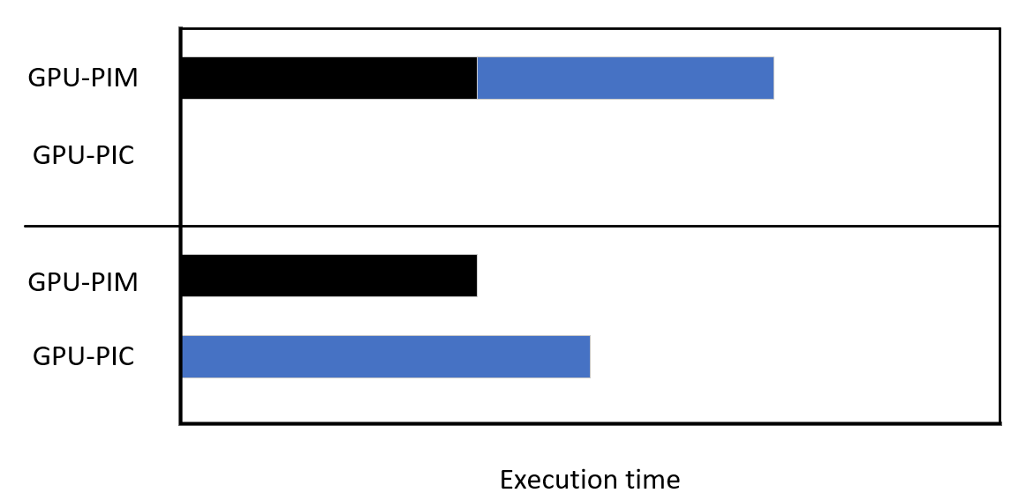
Research work—Technique
Concurrent kernel management.
Benefit.
Three key pieces of information.
Kernel-level dependence information to identify independent kernels.
Affinity of each kernel.
Execution time prediction for each kernel.

Slide 21
Research work—Technique
Concurrent kernel management.
Kernel-level dependence information to identify independent kernels.
Obtaining the dependence graph of an application for a given input by profiling the application’s execution to determine the correct and complete set of read-after-write (RAW) dependencies across the kernels.
Architecture Affinity Information.
Execution Time Information.

Slide 22
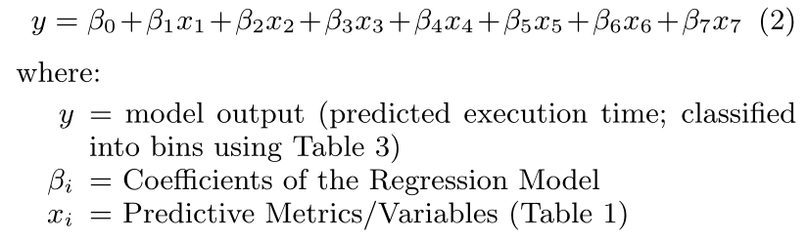
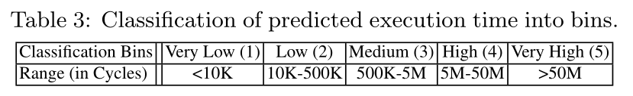
Research work—Technique
Concurrent kernel management.
Execution Time Prediction Model.
Linear regression model.
Accuracy : 77% and 80% on the test set for GPU-PIC and GPU-PIM.

Slide 23
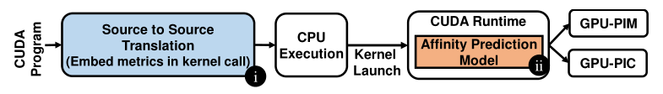
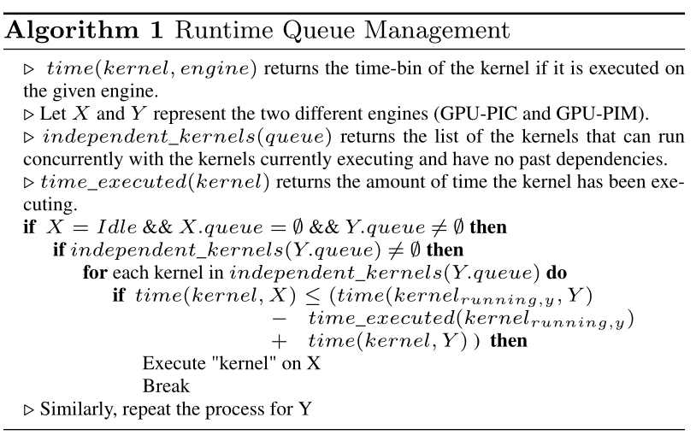
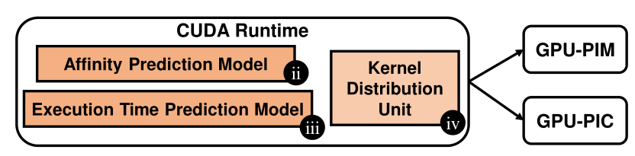
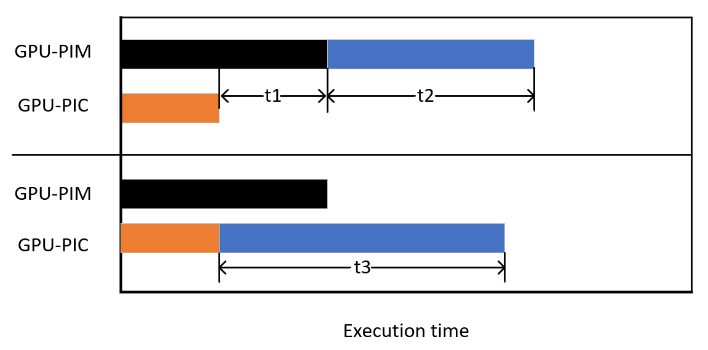
Research work—Technique
Concurrent kernel management.
Algorithm and Implementation.
t1+t2>t3 then offload the kernel to another processing unit.

Slide 24
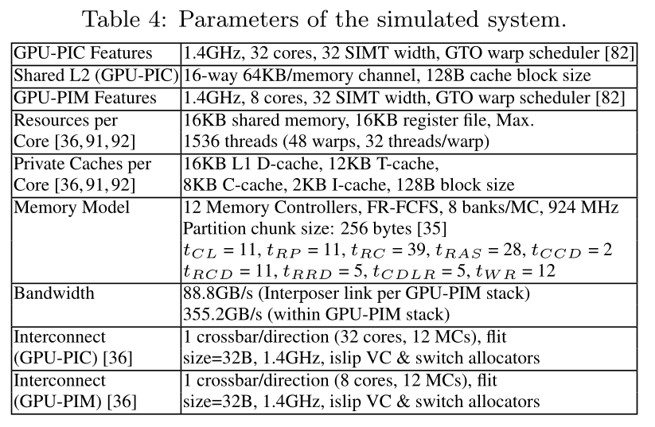
Research work—Evaluation
Methodology.
Algorithm and Implementation.
Simulator : GPGPU-Sim.

Slide 25
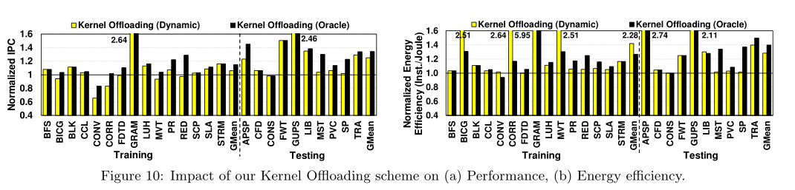
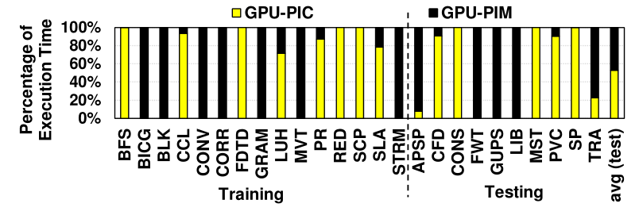
Research work—Evaluation
Effects of Kernel offloading.
Increasing the performance and energy efficiency of the testing set applications by 25% and 28%.
Percentage of execution time of GPU-PIM and GPU-PIC.

Slide 26
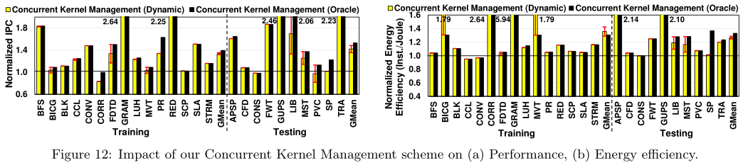
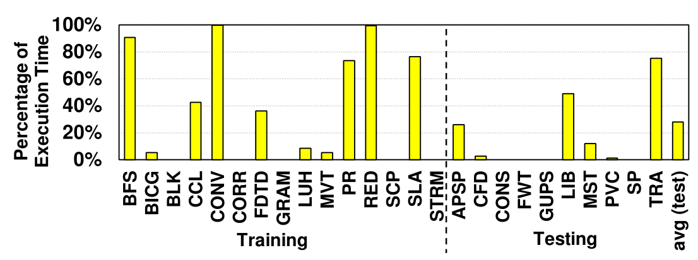
Research work—Evaluation
Effects of Concurrent Kernel Management.
Increasing the performance and energy efficiency of the testing set applications by 42%$±4\% and\text{ 27}\text{\%}±2\%.$
The execution time when kernels are concurrently running on GPU-PIM and GPU-PIC.

